Slide 1
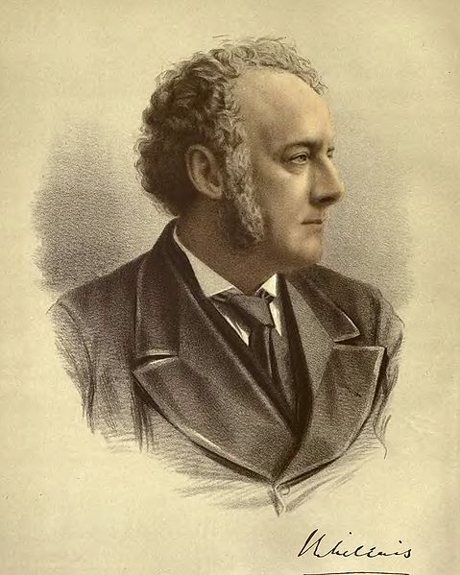
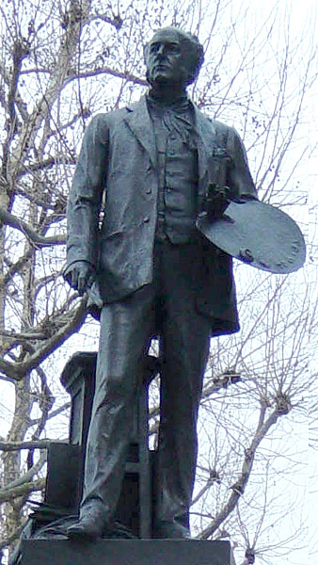

John Everett Millais
1829-1896
English Painter and Illustrator

Slide 2
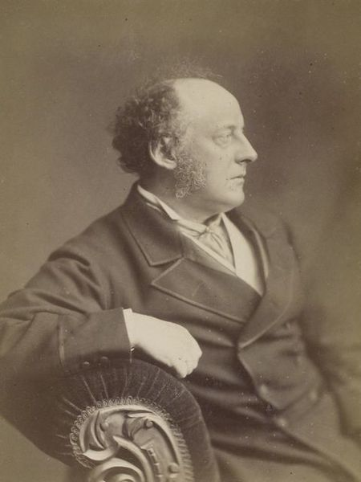
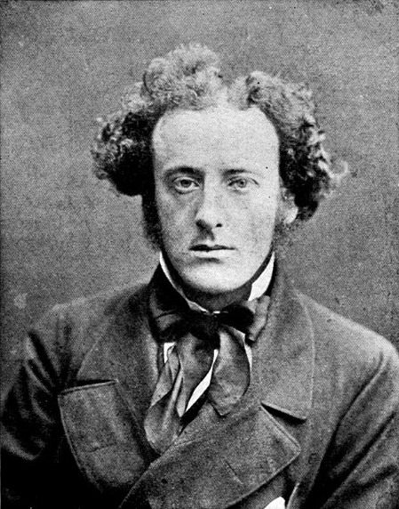
Photo 1854
Photo Later
Notes:
Photograph of Sir John Everett Millais 1854

Slide 3
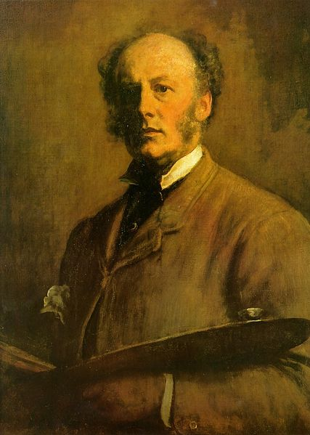
Self-portrait 1881
Notes:
Self-portrait 1881

Slide 4
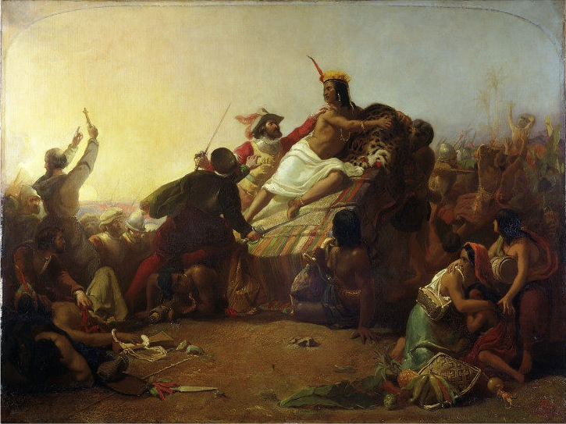
Notes:
Pizarro Seizing the Inca of Peru 1845

Slide 5
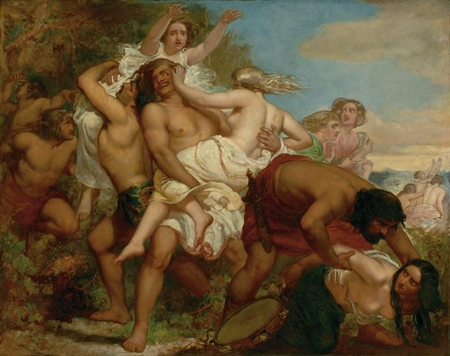
Notes:
Benjamin Seizes Daughter of Shiloh 1847

Slide 6
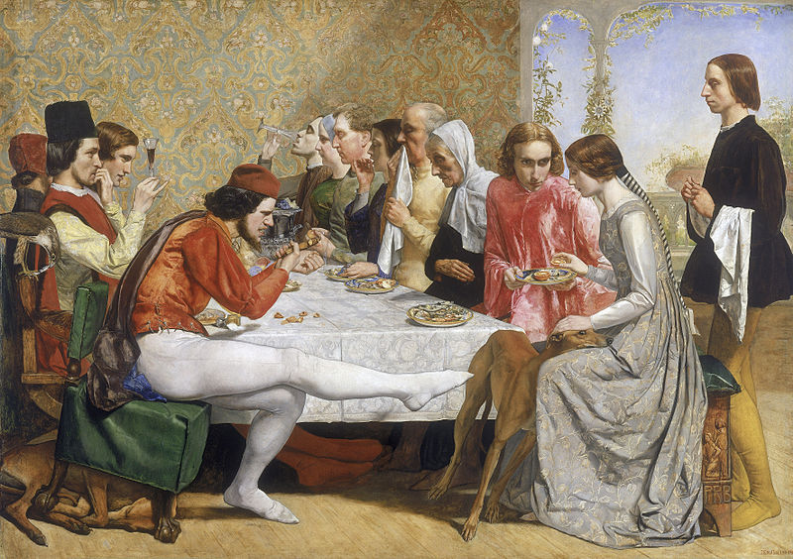
Notes:
Isabella 1849

Slide 7
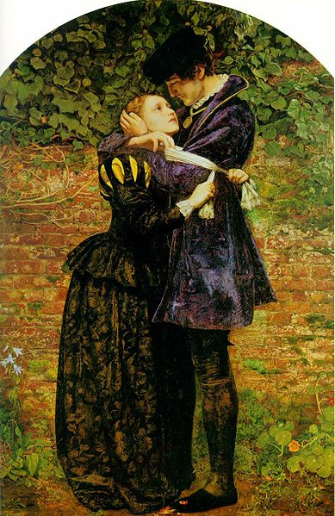
Notes:
Huguenot lovers on St. Bartholomew's Day 1852

Slide 8
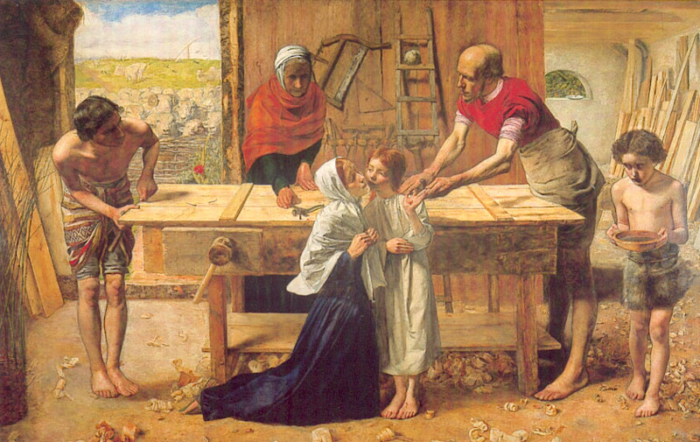
Christ in the house of his parents 1850
Notes:
Christ in the house of his parents 1850

Slide 9
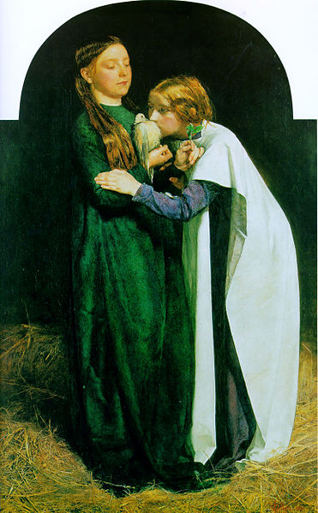
Notes:
The Return of the Dove to the Ark 1851

Slide 10
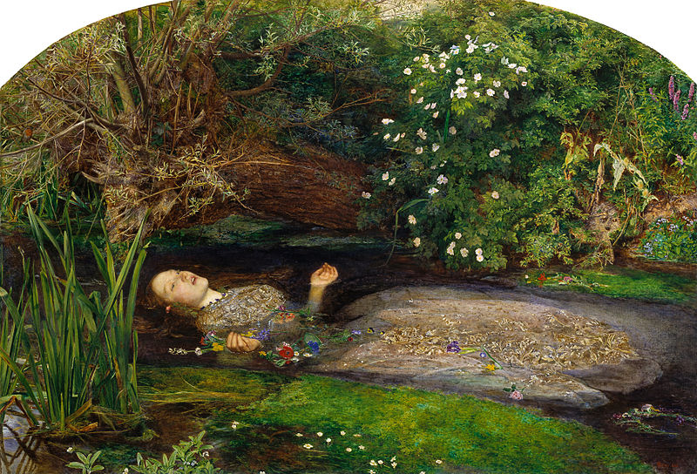
Notes:
Ophelia 1851

Slide 11
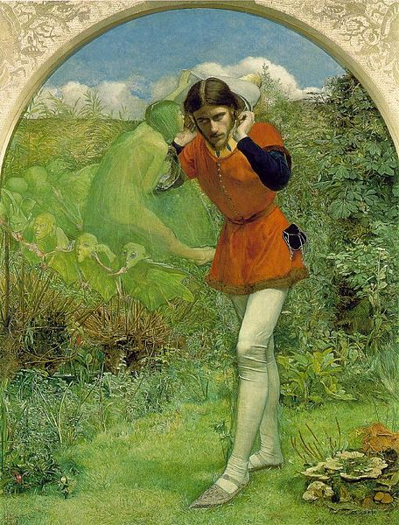
Notes:
Ferdinand Lured by Ariel 1850

Slide 12
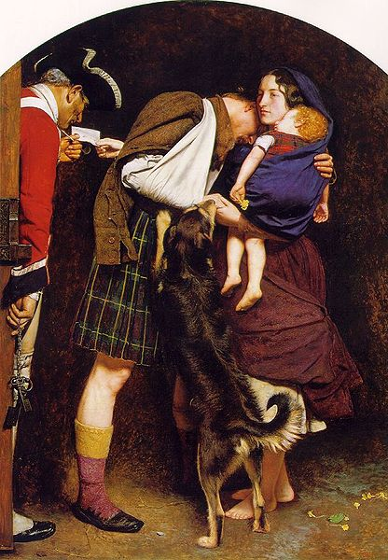
Notes:
The Order of Release 1853

Slide 13
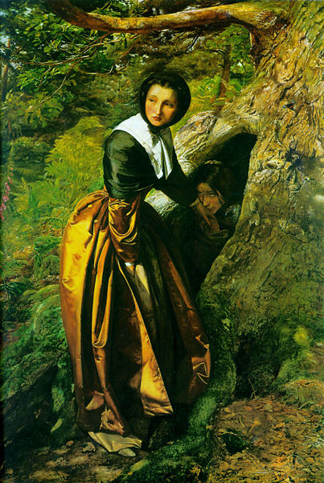
Notes:
The Proscribed Royalist 1853

Slide 14
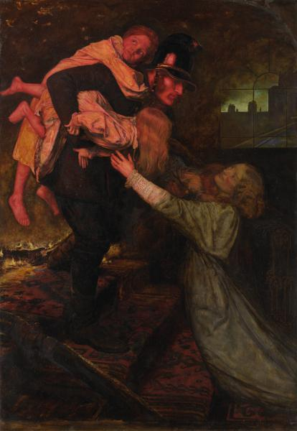
Notes:
The Rescue 1855

Slide 15
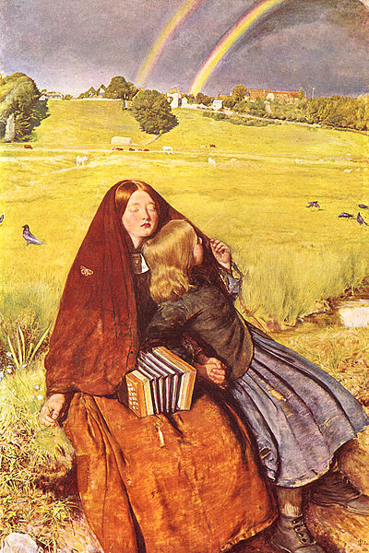
Notes:
The Blind Girl 1856

Slide 16
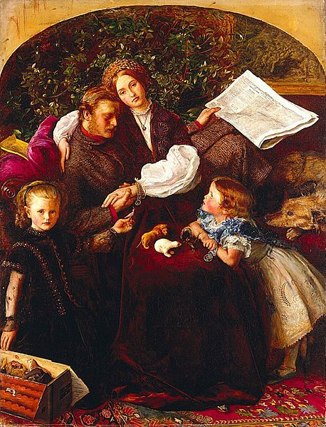
Notes:
Peace concluded 1856

Slide 17
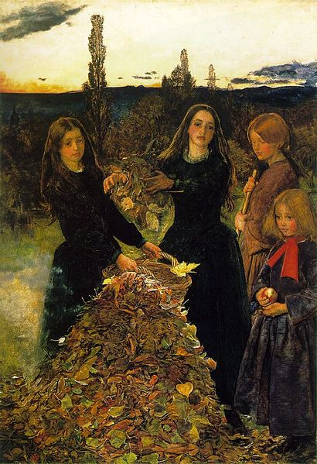
Notes:
Autumn Leaves 1856

Slide 18
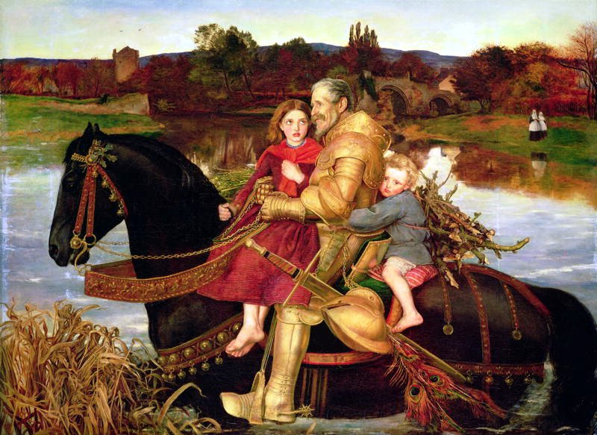
Notes:
Sir Isumbras at the Ford 1857

Slide 19
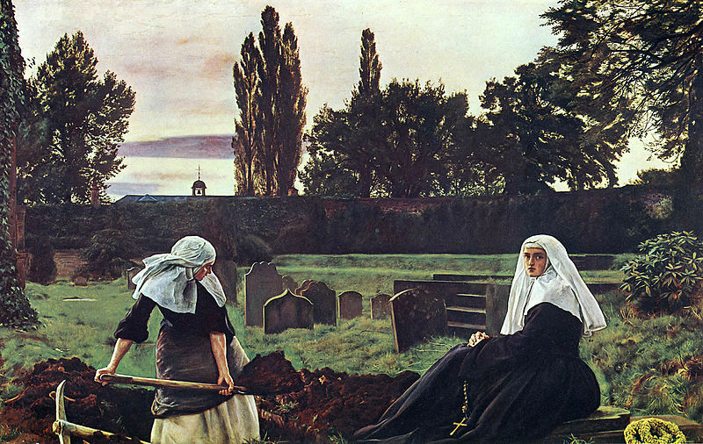
Notes:
The Vale of Rest 1858

Slide 20
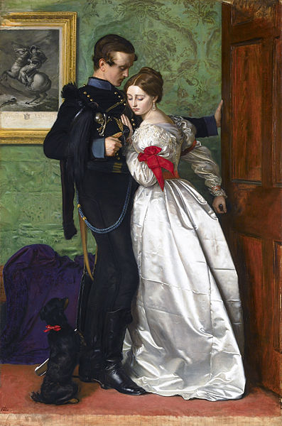
Notes:
The Black Brunswicker 1860

Slide 21
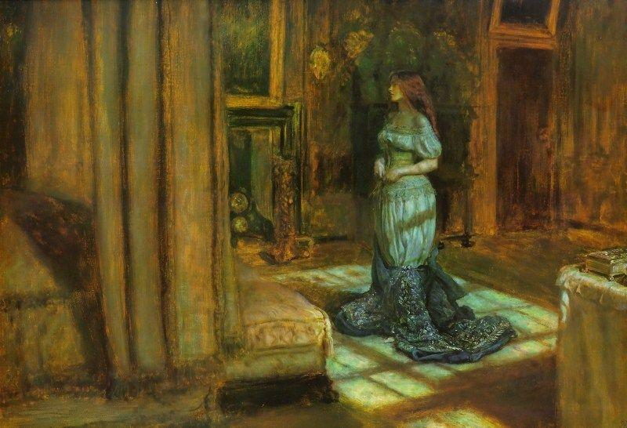
Notes:
Eve of St Agnes 1863

Slide 22
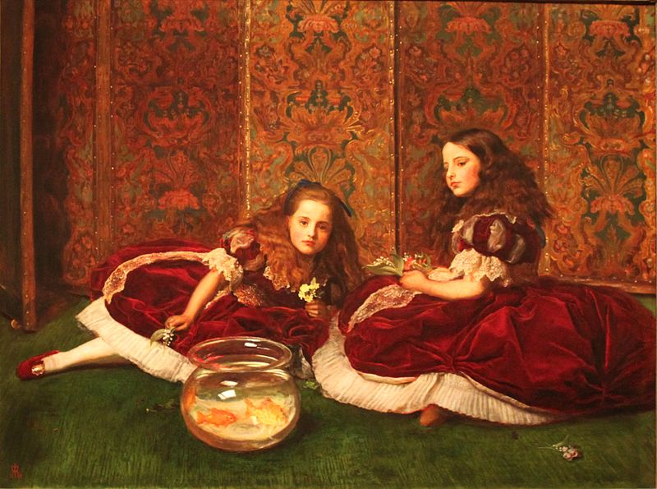
Notes:
Leisure Hours 1864

Slide 23
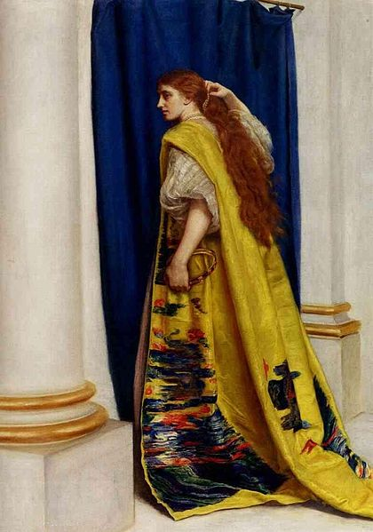
Notes:
Esther 1865

Slide 24
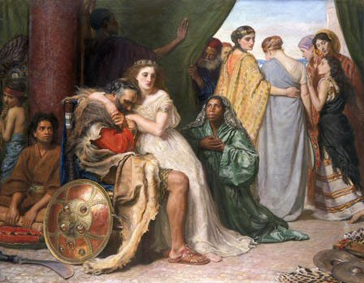
Notes:
Jephthah
1867

Slide 25
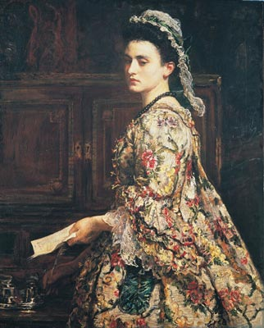
Notes:
Vanessa, 1868

Slide 26
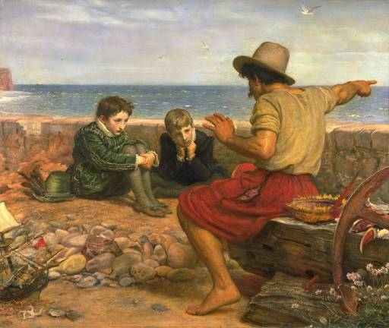
Notes:
The Boyhood of Raleigh, 1871

Slide 27
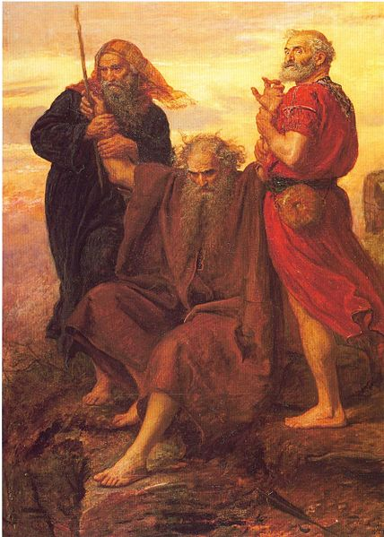
Victory O Lord
Notes:
Victory O Lord! 1871

Slide 28
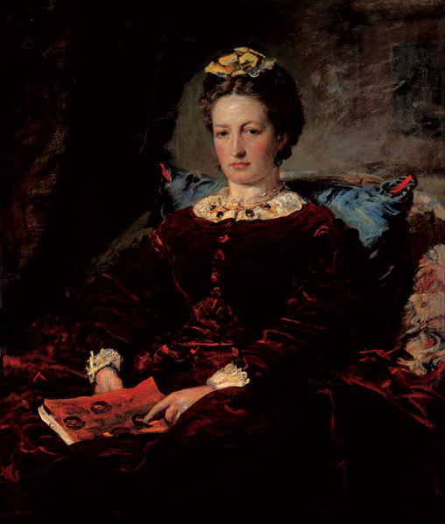
Notes:
Portrait of Effie Gray (1828-1897) 1860

Slide 29
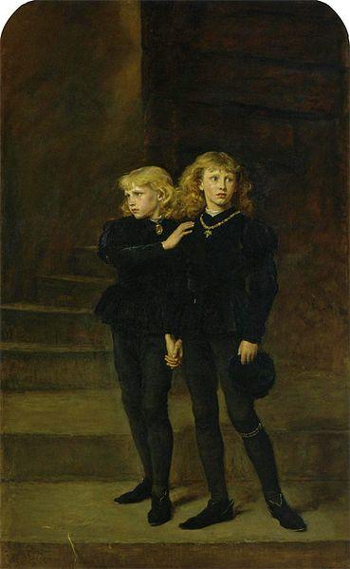
Notes:
The Princes in the Tower 1878

Slide 30
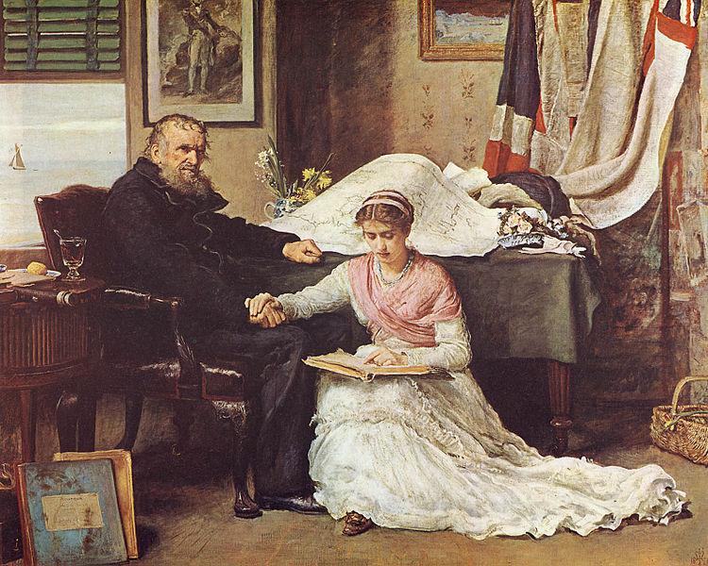
Notes:
The North-West Passage 1874

Slide 31
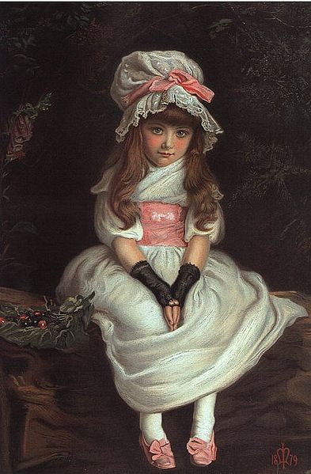
Notes:
Cherry Ripe 1879

Slide 32
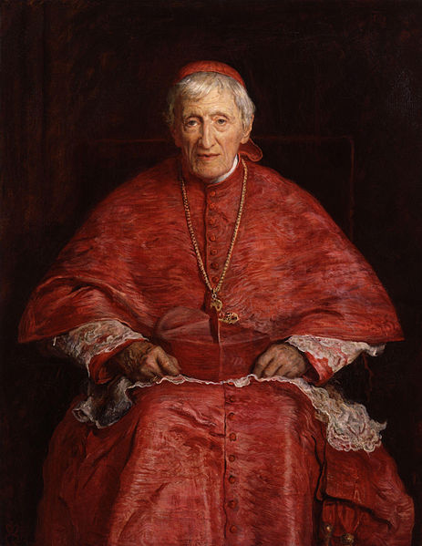
Notes:
John Henry Newman 1881

Slide 33
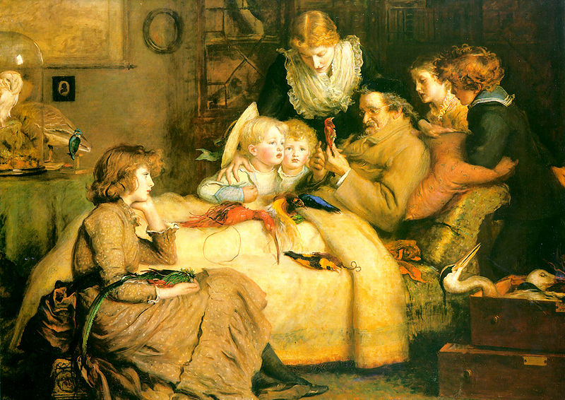
Notes:
Ruling Passion 1885

Slide 34
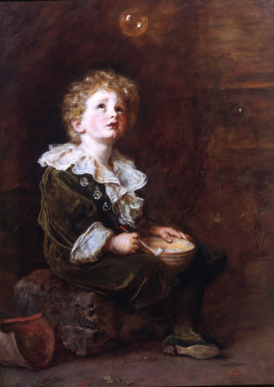
Notes:
Bubbles 1886

Slide 35
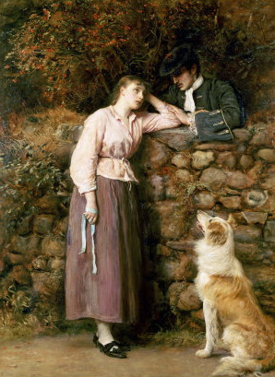
Notes:
Effie Deans 1877

Slide 36
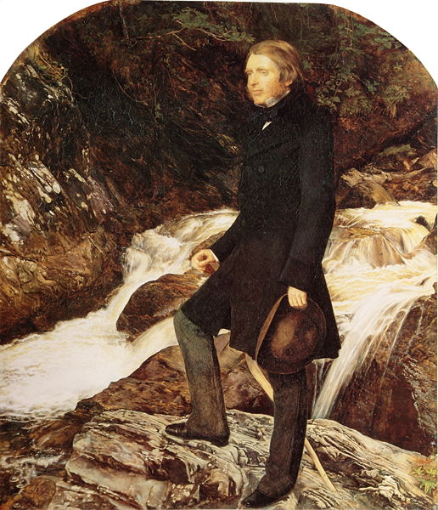
Notes:
Portrait of John Ruskin 1853-4

Slide 37
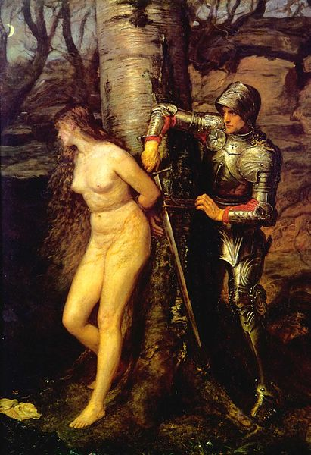
Notes:
Painting The Knight Errant 1870

Slide 38
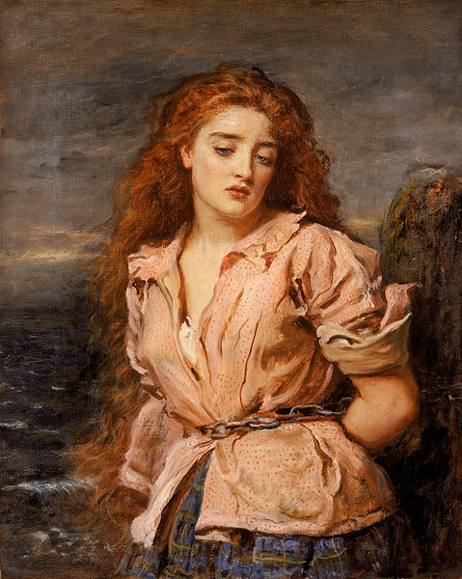
Notes:
The Martyr of the Solway 1871

Slide 39
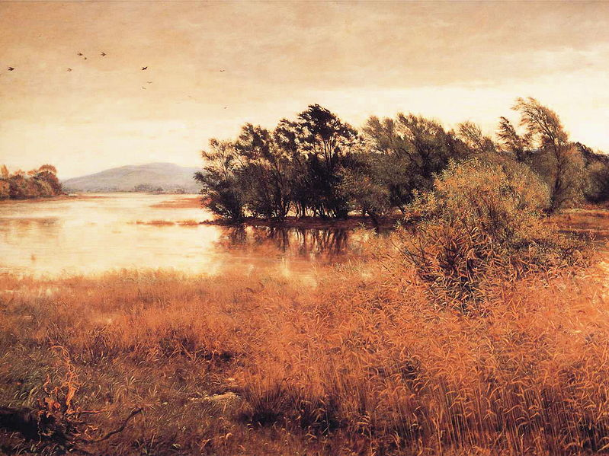
Notes:
Chill October 1870

